Slide 1
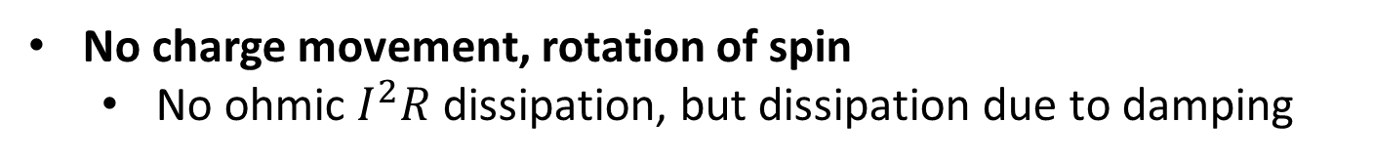
Spintronics: Spin-Electronics
Apart from having charge, an electron has spin
Spin
Up/Down 0/1 (binary information)
Charge
Electron
A rapidly developing nanotechnology
Store, non-volatile
Process
Communicate
In-built functionality
E _{barrier}
No charge movement, rotation of spin
No ohmic $I^{2}R$ dissipation, but dissipation due to damping
Key Issue
There is dissipation due to applying charge voltage/current
Notes:
Spin is the intrinsic angular momentum of an elementary particle as being the result of its rotation about its own axis
In Spintronics, information is stored and transmitted using another property of electrons called spin.
Electrons moving through a nonmagnetic material normally have random spins, so the net effect is zero. External magnetic fields can be applied so that the spins are aligned (all up or all down), allowing a new way to store binary data in the form of one’s (all spins up) and zeroes (all spins down).

Slide 2
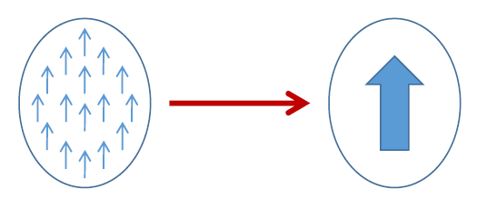
Single-domain nanomagnets
Exchange interaction
Pauli’s exclusion principle
Coulomb repulsion
Each electron small magnet
Ferromagnet
Ferrimagnet
Antiferromagnet
W.F. Brown Jr.,
The fundamental theorem of the ferromagnetic particle theory
Magnetic domain formation should be limited to very small dimensions (100 nm) because of the competition between the magnetostatic energy and the quantum-mechanical exchange energy, causing nanomagnets to behave like single giant spins.
Electron beam lithography (EBL)
Notes:
Single domain nanomagnets are formed due to exchange interaction, which is a simultaneous action of Pauli’s exclusion principle and Coulomb repulsion.

Slide 3


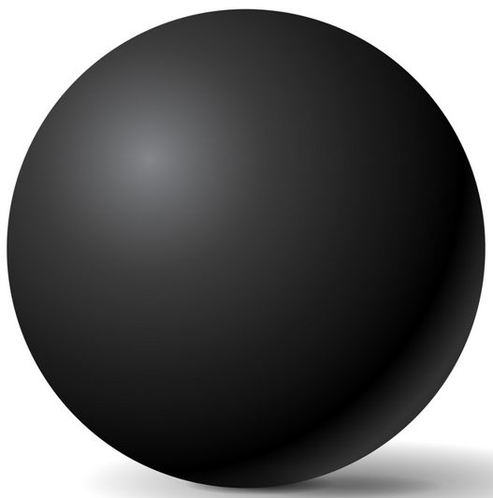
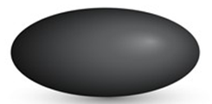
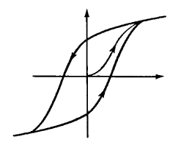
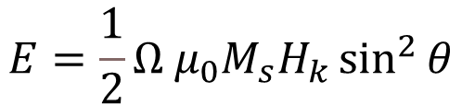





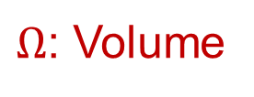



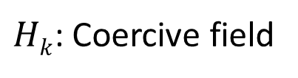
Magnetic anisotropy
x
30-80 KT at 300 K
Magnetization
In-plane
Shape anisotropy
$$ϕ$$
$$θ$$
z
$$E barrier$$
y
CoFeB
$$H_{k}=\left(N_{d_ yy}−N_{d_ zz}\right)M_{s}$$
$$φ=±90^{o}$$
$$θ={180}^{o}$$
$$θ=0^{o}$$
Perpendicular anisotropy
Sphere
$$E=\frac{1}{2}{Ω μ}_{0}M_{s}H_{k}\sin^{2}{θ}$$
CoCrPt
MgO
$Hk$: Coercive field
Ellipsoid
M
CoFeB
$Ω$: Volume
t_{CoFeB}<1.3 nm
$$Ms in A/m$$
H
Bulk
Interface
H_{k}
Notes:
If volume increases then E barrier also increases, because of that spontaneous fluctuation minimizes.
$N_{d−yy}$ id demagnetization factor

Slide 4
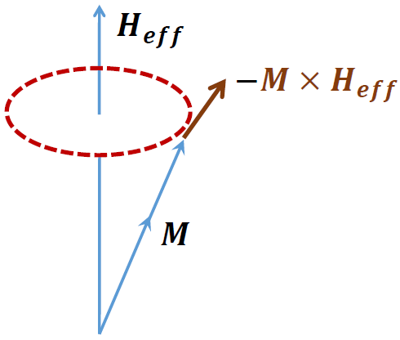
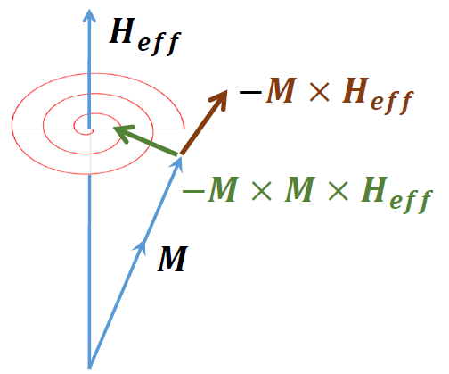
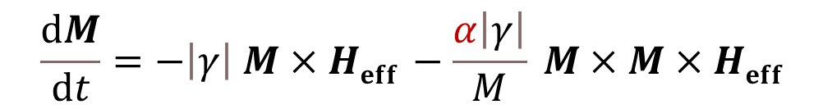
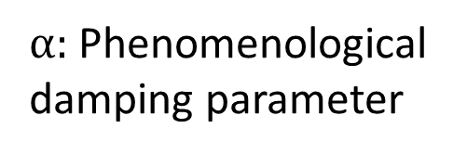
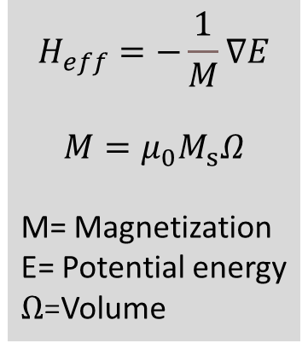
Magnetization dynamics Landau-Lifshitz (LL) equation
precession
$α:$Phenomenological
damping parameter
$$\frac{ⅆM}{ⅆt}=−\left|γ\right| M×Heff −\frac{α\left|γ\right|}{M} M×M×Heff$$
damping
$$H_{eff}=−\frac{1}{M}∇E$$
$$M=μ_{0}M_{s}Ω$$
M= Magnetization
E= Potential energy
$Ω$=Volume
precession
Landau and Lifshitz, Phy. Z. Sowjet. 8, 101 (1935)
Damping causes a transfer of energy from macroscopic motion to microscopic thermal motion, which results in internal energy losses
Performance metrics
Switching delay and energy dissipation
A damping parameter takes into account the rate of energy transfer

Slide 5
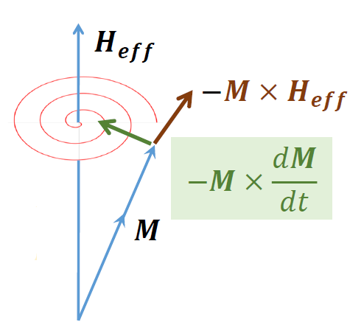
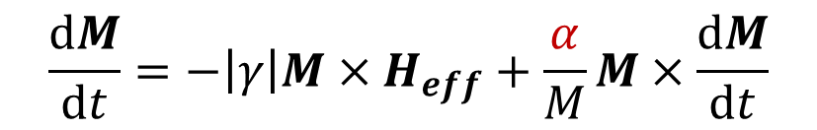
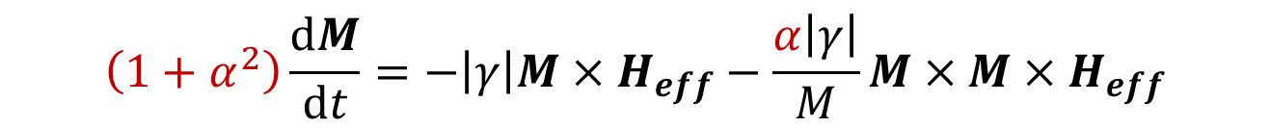
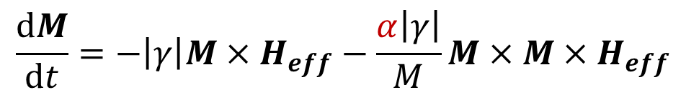
Magnetization dynamics Landau-Lifshitz-Gilbert (LLG) equation
LL
$$\frac{ⅆM}{ⅆt}=−\left|γ\right|M×H_{eff}−\frac{α\left|γ\right|}{M}M×M×H_{eff}$$
LL cannot account for large damping in thin Permalloy sheets, adjusted by Gilbert
damping
LLG
$$\frac{ⅆM}{ⅆt}=−\left|γ\right|M×H_{eff}+\frac{α}{M}M×\frac{ⅆM}{ⅆt}$$
damping
In standard form
$$\left(1+α^{2}\right)\frac{ⅆM}{ⅆt}=−\left|γ\right|M×H_{eff}−\frac{α\left|γ\right|}{M}M×M×H_{eff}$$
LL
LLG
Gilbert, IEEE Trans. Magn. 40, 3443 (2004)
Notes:
Landau and Lifshitz formulated the theory of dynamics of magnetization in ferromagnetic bodies

Slide 6
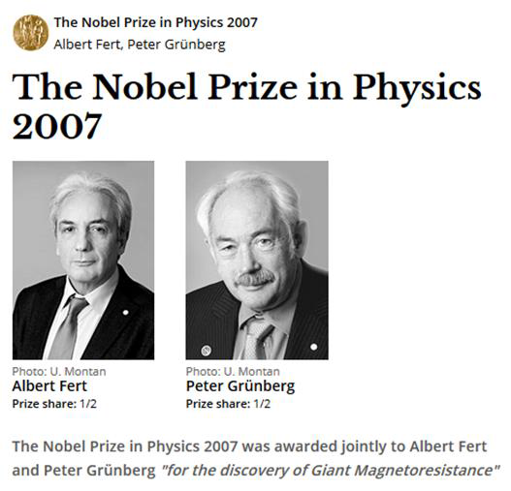

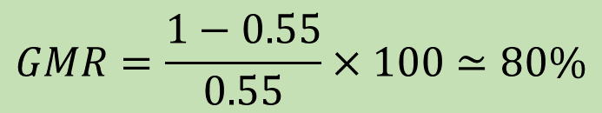
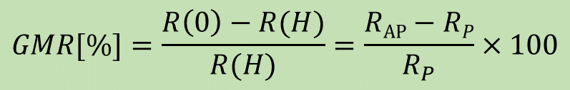


Giant Magneto-Resistance (GMR)
Giant Magneto-Resistance (GMR)
$$GMR=\frac{1−0.55}{0.55}×100≃80\%$$
$$\text{Fe}$$
$$\text{Cr}$$
$$\text{Fe}$$
1988
A. Fert, M.N Baibich et al., Phys. Rev. Lett. 61, 2472 (1988)
P. Grunberg, G. Binash et al., Phys. Rev. B 39, 4828 (1989)
$$GMR[\%]=\frac{R\left(0\right)−R(H)}{R(H)}=\frac{RAP−RP}{R_{P}}×100$$
Notes:
Magneto resistance: With the effect of magnetic field, how resistance get changed.

Slide 7
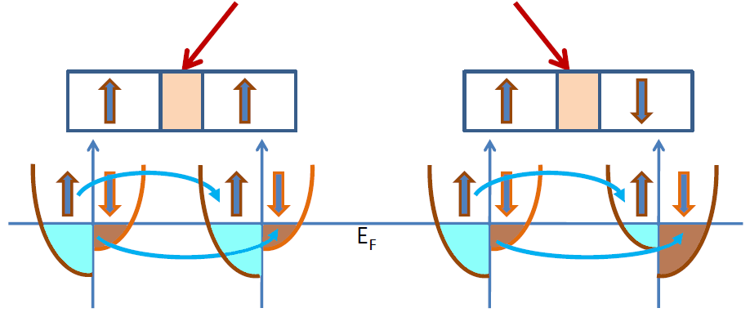






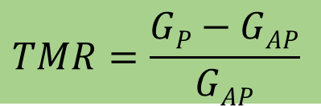

Tunneling magneto-resistance (TMR)
Insulator
e.g., Al₂O₃, MgO
Conductance is proportional to the density of states
N_{L}↑, N_{R}↑, N_{L}↓, N_{R}↓
Left (L)
Right (R)
Left (L)
Right (R)
$$G^{↑↑}∝N_{L}^{↑}{ N}_{R}^{↑}$$
$$G^{↓↓}∝N_{L}^{↓}{ N}_{R}^{↓}$$
$$G^{↓↑}∝N_{L}^{↓}{ N}_{R}^{↑}$$
$$G^{↑↓}∝N_{L}^{↑}{ N}_{R}^{↓}$$
$$EF$$
$$TMR=\frac{GP−GAP}{GAP}$$
Reported 1975 (prior to GMR)
TMR>500% using MgO spacer
$${GP=G}^{↑↑}+ G^{↓↓}$$
$${GAP=G}^{↓↑}+G^{↑↓}$$
Julliere, M. Tunneling between ferromagnetic film. Phys. Lett. A 54, 225-226 (1975)
Moodera, J. S. et al., Phys. Rev. Lett. 74, 3273 (1995)
Mathon, J. et al., Phys. Rev. B 63, 220403 (2001), Butler, W. et al., Phys. Rev. B 63, 054416 (2001)
Yuasa, S. et al., Nature Mater. 3, 868 (2004), Parkin, S. et al., Nature Mater. 3, 862-867 (2004)

